Slide 1


Designing a Disruption Tolerant Network for Reactive Spacecraft Constellations
Sreeja Nag
BAER Institute, NASA Ames Research Center
Published by the American Institute of Aeronautics and Astronautics, Inc., with permission.
Co-Authors: Marc Sanchez Net (JPL/CalTech), Alan S Li (ARC/BAER), Vinay Ravindra (ARC/BAER)

Slide 2
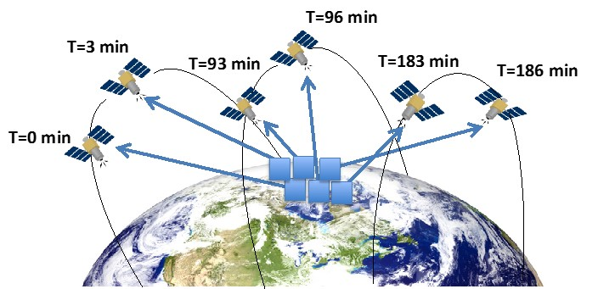
Agile Spacecraft Constellations Maximizing Coverage and Revisit
Small Sat constellation + Full-body reorientation agility + Ground scheduling autonomy = More Coverage, for any given number of satellites in any given orbits
Using Landsat as first case study w/ a 14 day revisit. Daily revisit needs ~15 satellites or 4 satellites with triple the FOV. Agile scheduling allows 2 sat constellation over 12 hours to observe 2.5x compared to the fixed pointing approach. 1.5x with a 4-sat constellation
S. Nag, A.S. Li, J.H. Merrick, "Scheduling Algorithms for Rapid Imaging using Agile Cubesat Constellations", COSPAR Advances in Space Research - Astrodynamics 61, Issue 3 (2018), 891-913

Slide 3
Agile Spacecraft Constellations Maximizing Coverage and Revisit
Small Sat constellation + Full-body reorientation agility + Ground scheduling autonomy = More Coverage, for any given number of satellites in any given orbits
Using Landsat as first case study w/ a 14 day revisit. Daily revisit needs ~15 satellites or 4 satellites with triple the FOV. Agile scheduling allows 2 sat constellation over 12 hours to observe 2.5x compared to the fixed pointing approach. 1.5x with a 4-sat constellation
If such schedulers can be adapted for onboard execution, Inter-Satellite Links (ISLs) for exchanging observations, inferences and plans will increase operational agility
S. Nag, A.S. Li, J.H. Merrick, "Scheduling Algorithms for Rapid Imaging using Agile Cubesat Constellations", COSPAR Advances in Space Research - Astrodynamics 61, Issue 3 (2018), 891-913

Slide 4
Concept of Operations (Ground-Based or Onboard)
S. Nag, A. S. Li, V. Ravindra, M. Sanchez Net, K.M. Cheung, R. Lammers, B. Bledsoe, "Autonomous Scheduling of Agile Spacecraft Constellations with Delay Tolerant Networking for Reactive Imaging", International Conference on Automated Planning and Scheduling SPARK Workshop, Berkeley CA, July 2019

Slide 5
Communication System Design
Baseline: 24 satellites organized in a 3-plane Walker constellation at 710 km Sun-synchronous orbit, observing floods in 5-40 global regions over a 6 hour simulation duration
Narrow field of view radars with an 8km footprint for the satellite payload, based on the RainCube mission, to observe precipitation and infer floods
Baseline scheduler uses greedy, dynamic programming
Comm system – physical layer, data link layer, network layer based on delay/disruption tolerant network (DTN) paradigm, an emerging protocol suite for routing data in dynamic and intermittent operational environments. DTN provides a store-and-forward mechanism that ensures reliable data delivery via a schedule-aware bundle routing mechanism that uses a ‘contact plan’ describing the current and future connectivity of the network to obtain a routing solution

Slide 6
Communication System – Physical Layer
Intra-plane distance to be nearly constant at ~5425km and the inter-plane distance to vary between 80 km and 6060 km
All spacecraft are equipped with a Solid State Power Amplifier to deliver 20W of RF power and a nadir-zenith dipole antenna
½ LDPC (low-density parity-check) coding scheme, Binary Phase Shift Keying (BPSK) modulation, SRRC (square root raised cosine) pulse shaping and NRZ baseband encoding
We closed the link budget at 1 kbps
Interference is addressed in the data link and network layers

Slide 7
Communication System – Data Link Layer
Three Multiple Access (MA) schemes considered: CDMA (Code Division Multiple Access), MF-TDMA (Multi-Frequency Time Division Multiple Access) and MF-FDMA (Multi-Frequency Frequency Division Multiple Access)
 | CDMA | MF-FDMA | MF-TDMA
Advantages | Heritage at NASA; e.g. TDRS uses it for MA and is standardized in CCSDS Simple to implement from the radio and software standpoint. | Typical way of implementing MA in space provided there is enough bandwidth for the application; e.g., commercial communication cannot use it. Separation of data from different users is simply achieved by filtering. | Simple frequency plan with few bandguards. User separation is achieved at frame level through software processing. Each radio only requires three tracking loops, thus reducing complexity.
Disadvantages | System performance is limited by interference power from other users transmitted simultaneously. Can interfere with TDRS MA users Losses grow faster than exponentially. | Requires enough bandguards to ensure Doppler shift in inter-plane communication results in out-of-band transmission. Increased radio complexity due many tracking loops needed. Requires dedicated S-band allocation | Requires time synchronicity which might be difficult to achieve in space. Frequency-Time duality only valid if underlying link data rate can be scaled up to compensate for pause times (which is not true for power constrained links). Requires dedicated S-band allocation

Slide 8
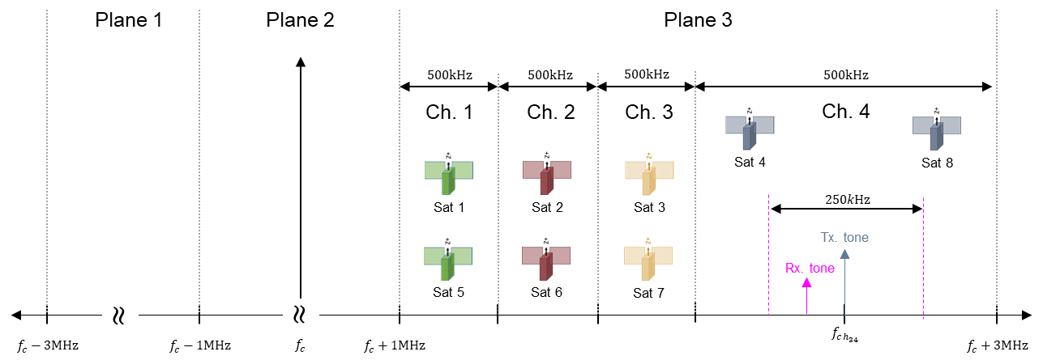
Communication System – Data Link Layer
MF-FDMA, despite being the conceptually simplest approach, was considered to be the best alternative given a 6 MHz bandwidth allocation at S-band
The initial 6 MHz are first divided into three 2 MHz partitions, one for each orbital plane. Each of these 2 MHz is then split into four 500 kHz channels that are used to transmit by two satellites 180 deg apart within the orbital plane

Slide 9
Communication System – Data Link Layer
Maximum available symbol rate is 200 ksps, max required symbol rate 2 ksps
At the receiver, an upper bound on the experienced Doppler shift is approximately ±124 kHz (two oncoming satellites at 7.8km/s each) fits well within the 500 kHz of the allocated channel.
MF-FDMA avoids interference without any data rate penalty.

Slide 10
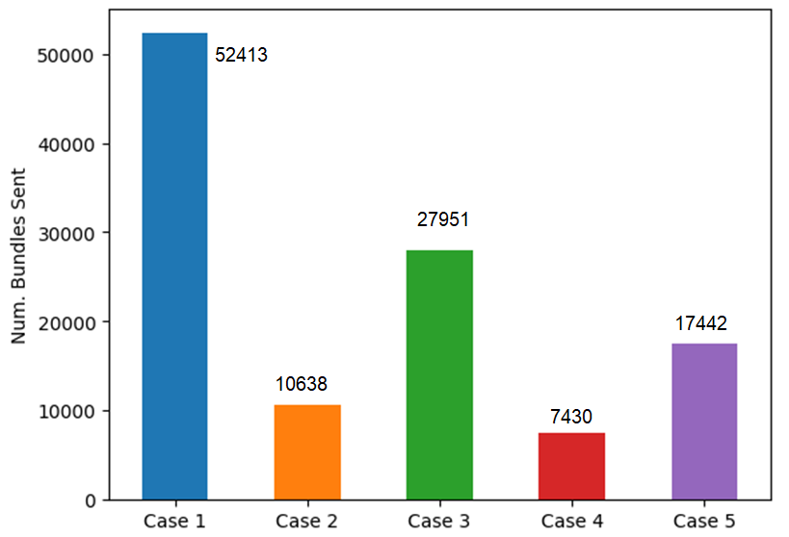
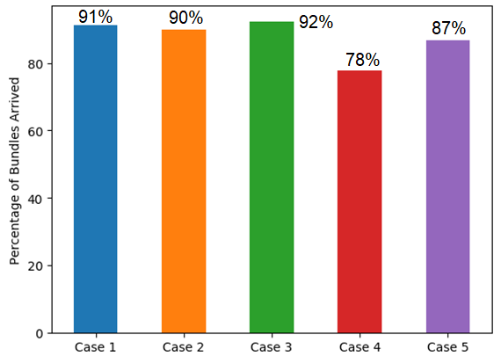
Communication System – Network Layer
DTN model is implemented in Python using Simpy, a discrete-event engine built upon the concept of coroutines
DTN has many core protocols - Parts of the Bundle Protocol and Schedule Aware Bundle Routing Protocol were implemented.
Packets are routed doing a shortest path search over the time-varying network topology. The objective is to minimize the best case packet delivery time.
Traffic Case Studies for 2kbits per grid point observed in 40 cities worldwide (1), 10 cities located close to each other (2) and sparsely worldwide (3), and 5 cities located closely (4) and sparsely (5).
Traffic generated across 5 traffic profiles
Bundles that arrived to destination satellites

Slide 11
Communication System – Network Layer
Use Case 5 - 8341 2kbit bundles generated by all 24 satellites and sent over a 6 hour simulation
DTN simulation uses OM inputs: Contact plan is the basis for all routing decisions + bundle creation time, source, destination, and relative priority flag for each destination node
Time-To-Live (TTL) property of all bundles is a function of its priority

Slide 12
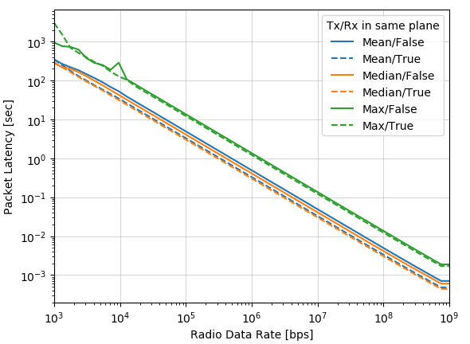
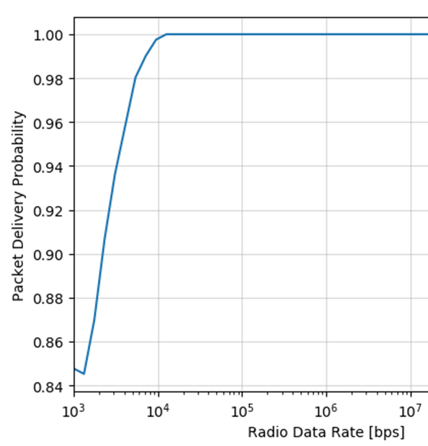
Communication System – Network Layer
Single bundle and aggregated bundle delivery explored. Little difference in successful delivery probability, larger latency with later start times, less variance because fewer packets sent
Network stability explored based on dependence of latency on packet creation time. If the network is operating in an unstable point of operation (i.e. too congested), bundles created later in the simulation should experience more latency as buffers in all DTN nodes are increasingly full
Data rate dependence explored. Increasing data rate by an order of magnitude results in an order of magnitude decrease in bundle delivery latency

Slide 13
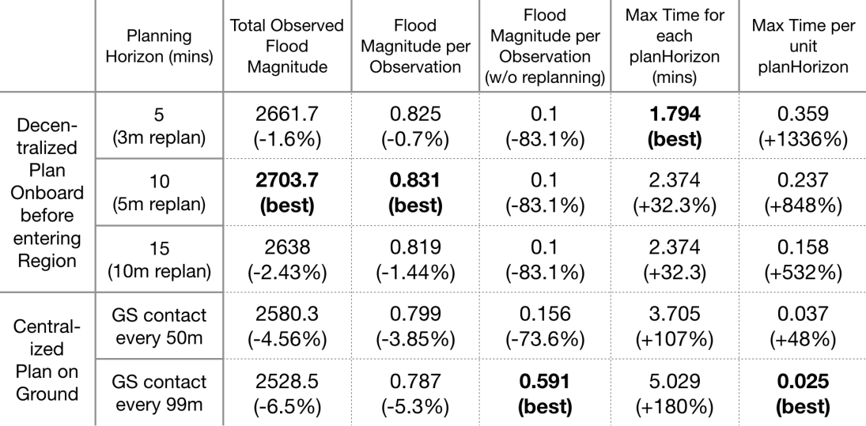
Full System Simulations (Ground-Based or Onboard)
Compared the performance of onboard scheduling with DTN links enabled (3 cases) against a ground based implementation (corresponding to 7 to 4 ground station contacts in the 6-hr sim)
Even when each satellite gets 30 GS contacts/day, value updates are from at least an orbit earlier due to collection-uplink-reschedule-downlink latency between any satellite pair => total and unit flood magnitude observed is ~4% less than any DTN-enabled decentralized run
Same constellation with non-agile satellites observes ~98% lower flood magnitude than the DTN-enabled case

Slide 14
Conclusions and Future Work
Physical layer - possible to deploy a constellation with inter and intra-plane links at 1kbps over a wide range of distances
Data link layer - recommended that constellations secure 3 MHz of BW at S-band to operate. This ensures that interference can be fully mitigated by frequency multiplexing
Network layer - While the performance is acceptable with links at 1kbps, much better performance is expected if the average data rate is increased by 10x
In the future, we will:
Consider (1) alternative implementations to the physical layer that enable this 10x improvement (e.g., variable data rate), and (2) reducing link range and contact times.
Show how performance varies as a function of constellation topology, EO observation targets and density, and spacecraft specifications
Show how performance improves with a hybrid approach of satellite and ground nodes

Slide 15
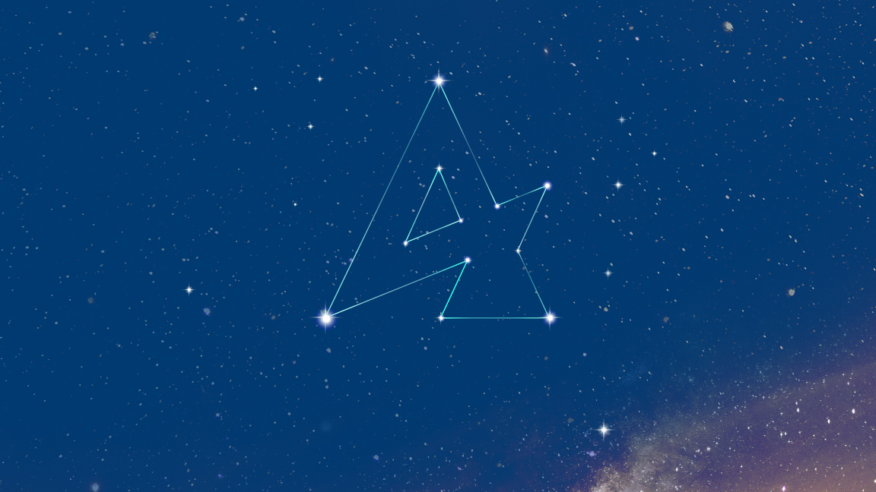
Questions?
Sreeja.Nag@nasa.gov
sreejanag@alum.mit.edu

